Slide 1

DATA-2206-01 – CAPSTONE WATER POTABILITY ANALYSIS
SUBMITTED BY:
ARSHIYA MUSLIM NOOR (100839688)
DIMPLE DINESH PARMAR (100852388)
PRADEEP RAJASHEKARAN (100848443)

Slide 2
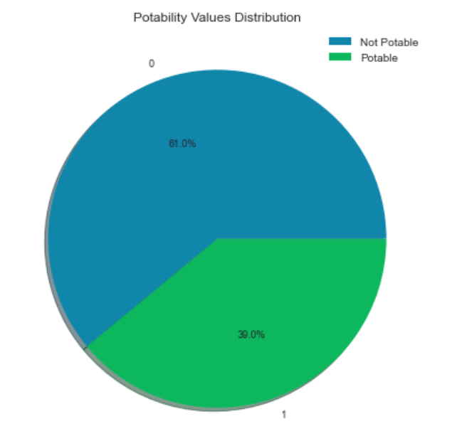
INTRODUCTION
In this project we have performed machine learning prediction analytics on water quality indicators to check the potability of the water based on the Ph level, hardness, solids, chloramines, sulphate, its conductivity, organic carbon, trihalomethanes and turbidity. This analysis will help us determine if the water is fit for human consumption or not.
The goal is the prediction of water potability using different machine learning algorithms.
Results will be compared to find the most accurate model for future predictions. This analysis will provide us the following outcomes -
Predict if the water quality is fit for human consumption.
Find features that contribute the most to water potability.

Slide 3
DATASET
The dataset used is synthetically generated and sourced from Kaggle. It consists of 3276 rows of recorded instances and has 9 columns of independent variables which are affecting the dependent variable noted in the 10th column which is Potability.
We performed the exploratory data analysis including univariate, bivariate and multivariate analysis on the dataset to understand the following –
There are structural errors and null values that had to corrected.
Distribution plot - shows features are normally distributed with very little skewness.
Box plot – shows there are outliers that needs to be eliminated.
Heatmap – shows there is minimal to no correlation between any of the features.
Pair plot - shows there are no significant clusters in our dataset.
Box plot and correlation values - show no strong correlation of the features with portability.
P-value - shows Hardness and Ph to be the most significant features in comparison to the rest while determining the potability.
Profile report - gives details of variables, interactions, correlations and missing values in the report.

Slide 4
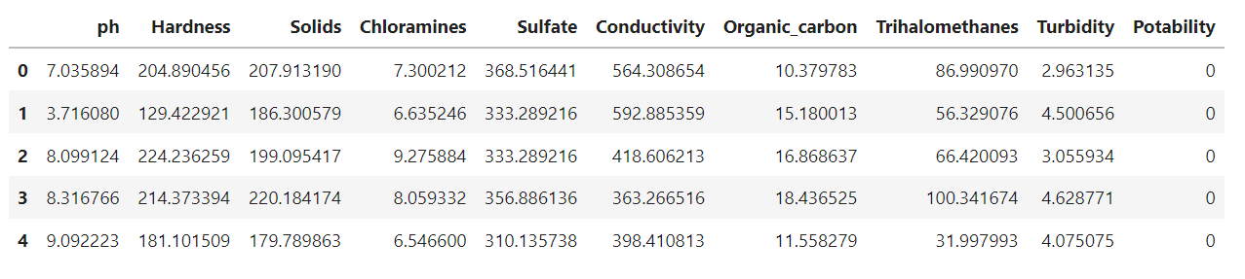
DATA PREPARATION AND CLEANSING
Structural errors - We shifted the decimal by dividing the solids value by 100 to correct the values in TDS column data and fixed the structural error.
Handling Outliers – We removed 325 rows of outliers after visualizing them in boxplot. After removing the outliers, the dimensions of our data are 2951 rows and 10 columns.
Null Values - There were 1434 rows of missing value which constitutes 4.4% of overall data. Missing values were replaced by the median of respective feature columns.
Duplicated Values – There were no duplicates, hence no changes were made.

Slide 5
METHODOLOGY AND METRICS
DATA SCALING - Makes it easy for a model to understand the problem and ensure that one factor will not impact the model just because of its large magnitude.
SPLITTING THE TRAIN AND TEST - Prevents our model from overfitting. We have assigned 20% of the data for testing. The dimension of the train data is (2360, 9) and the test data is (591, 9).
MODELING – We built 7 models to compare the results of each model to determine the one with the best performance for our analysis.
CONFUSION MATRIX AND CLASSIFICATION REPORTS – These will provide us evaluation metrics. We will compare Accuracy and Precision to find the best model. We will weigh precision more because our aim is to find the trueness among the actual potable water.
ROC CURVE - ROC Curves summarize the trade-off between the true positive rate and false positive rate for a predictive model using different probability thresholds. Hence, it will be appropriate for us to use ROC and AUC to further evaluate our models.

Slide 6
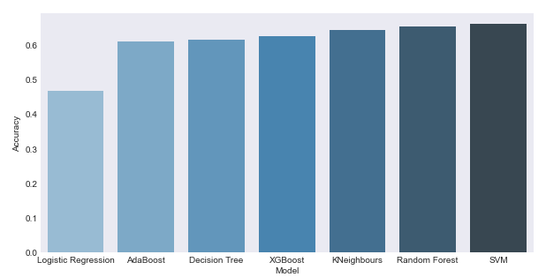
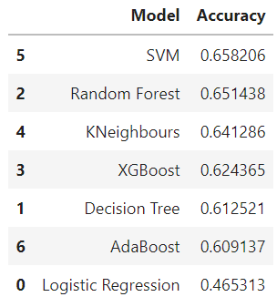
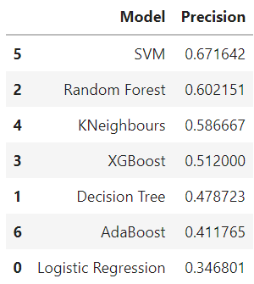
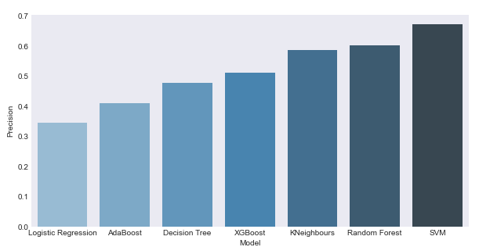
MODELING
We have used 7 difference machine learning algorithms for modeling.
Logistic Regression
Decision Tree Classifier
Adaboost Classifier
K-neighbors Classifier
XGBoost Classifier
Random Forest Classifier
SVM (Support Vector Machine)

Slide 7
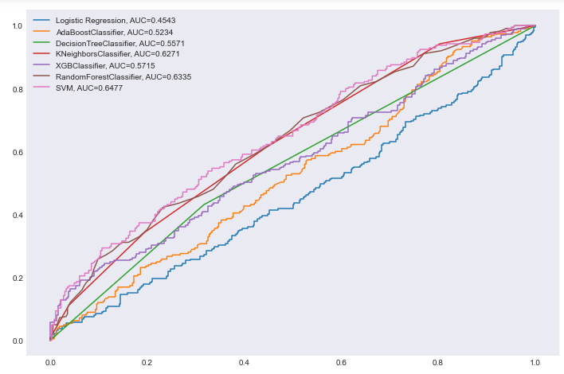
MODEL SELECTION
Comparing all the model results, we can see that SVM has performed the best of all with following results. It is a discriminative model which works on geometric interpretation of the data.
Accuracy : 0.66
Precision : 0.66
Recall : 0.66
AUC : 0.6477
The next best model is Random Forest algorithm.

Slide 8
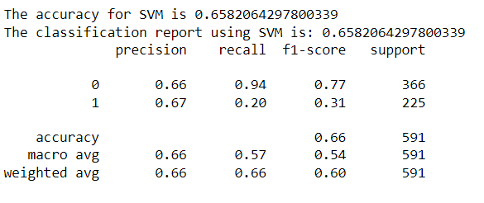
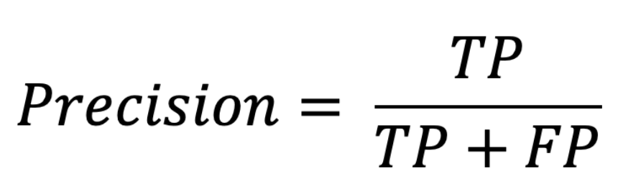
SVM CLASSIFICATION REPORT
In precision, False Positive is in the denominator, and it inversely affects the precision. THE LOWER THE FP IS HIGHER THE PRECISION IS. Hence, precision is what we will evaluate our model with and SVM has 0.66 precision. The model has predicted 66% of the trueness of water being potable. Also, the accuracy of the model is the best among all the rest of the models at 66%.

Slide 9
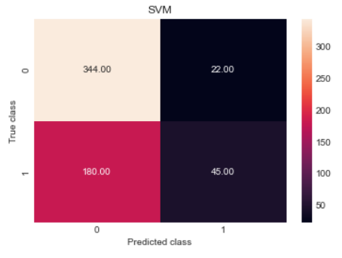
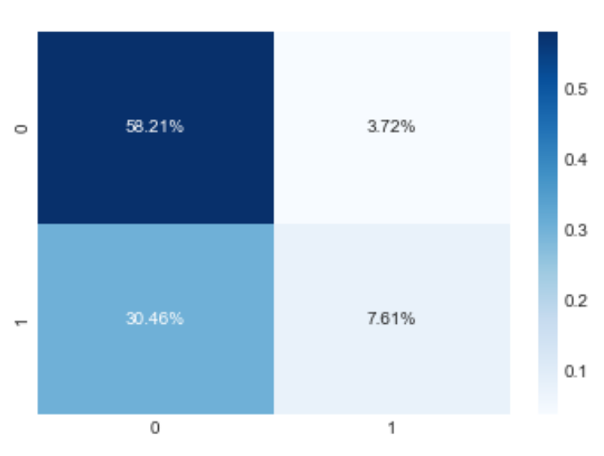
SVM CONFUSION MATRIX
True Negative - 58% or 344 of the times when the water was non-potable and predicted non-potable correctly.
True Positive - 7.61% or 45 of the times when water was potable and shows potable correctly.
False Positive - 3.72% or 22 of the times water was non-potable but predicted to be potable incorrectly.
False Negative - 30.46% or 180 of the times water was potable but predicted non-potable incorrectly.

Slide 10
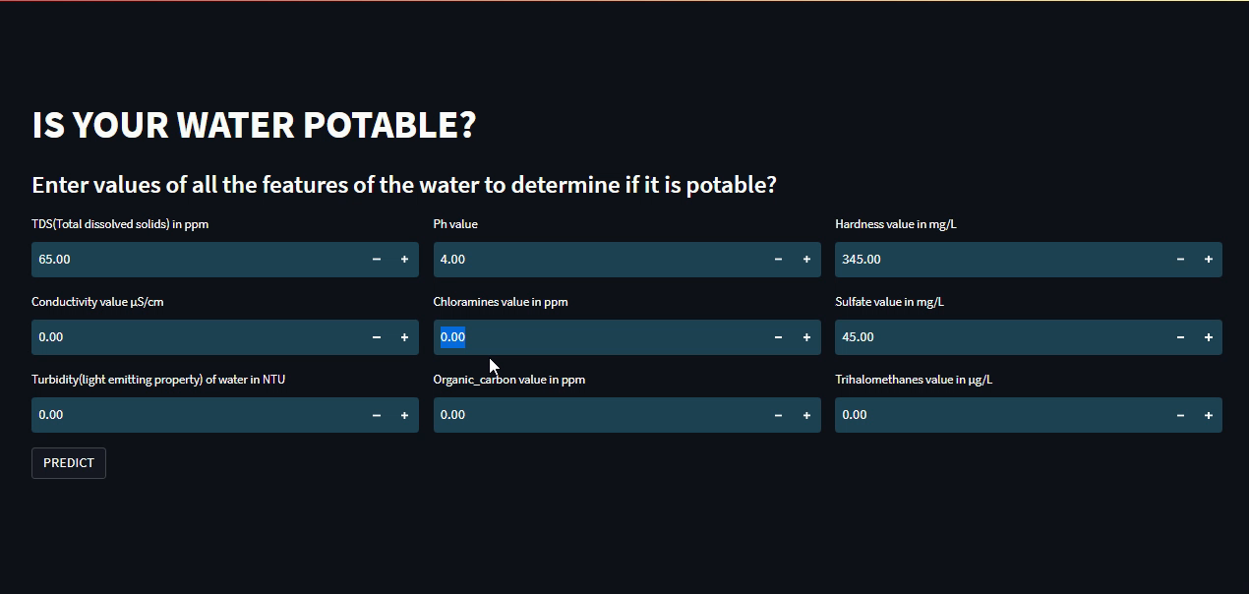
INTERFACE

Slide 11
RECOMMENDATIONS
This dataset is a synthetically generated and not a real dataset and due to this there are some limitations. This can be solved using a real dataset. Using a real dataset will improve the overall performance of models and provide accurate predictions that can be applied to resolve real world problems.
Adding region as a feature to the dataset will help us expand our analysis, as we can show which regions water is non potable mostly and the government can take measures to address these concerns for the welfare of the society.
For huge data sets, the support vector machine approach may not suitable and, they are computationally expensive to train. Hence, exploring other classifiers for larger datasets are recommended.
Hyper parameter tuning to get a more accurate prediction for other models is always recommended as this will influence how model’s parameter can be updated and learned during training. Models can give a greater accuracy by learning the most optimal weights with a given training algorithm and data.
To boost accuracy, Ensemble Methods are also recommended. Using Ensemble learning technique several learners are combined to obtain a better performance than any individual learners. It is often used to improve classification and prediction.

Slide 12
REFERENCES
JAY. (2021, July). Water Quality: Analysis (Plotly) and Modelling. Retrieved from Kaggle: https://www.kaggle.com/code/jaykumar1607/water-quality-analysis-plotly-and-modelling
KADIWAL, A. (2021). Kaggle. Retrieved from Water Quality: https://www.kaggle.com/datasets/adityakadiwal/water-potability
KONSTANTIN, T. (2021, September). Exploring and Predicting Drinking Water Potability. Retrieved from Kaggle: https://www.kaggle.com/code/thomaskonstantin/exploring-and-predicting-drinking-water-potability
Leech, J. (2020, June 30). 7 Science-Based Health Benefits of Drinking Enough Water. Retrieved from Healthline: https://www.healthline.com/nutrition/7-health-benefits-of-water
Week 5: Machine Learning Fundamentals. (n.d.). Retrieved from DC Connect: https://durhamcollege.desire2learn.com/d2l/le/content/430948/viewContent/5745823/View

Slide 13

THANK YOU

